Slide 1
IDP L102
Ben, Boris, Bruno, Iain, Jon, Nirmay, Oscar

Slide 2
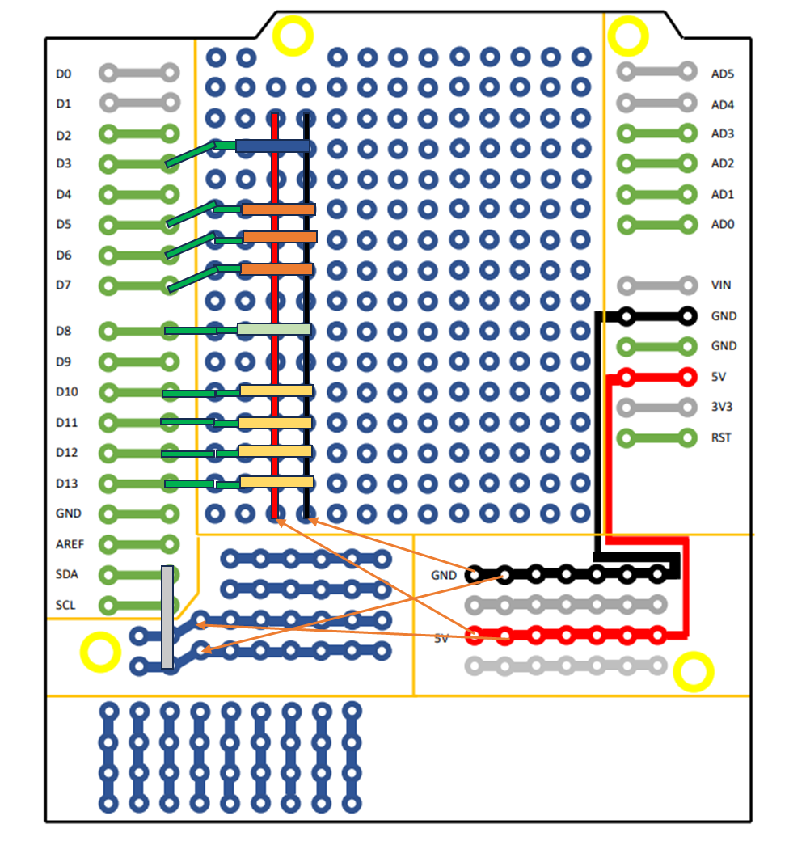
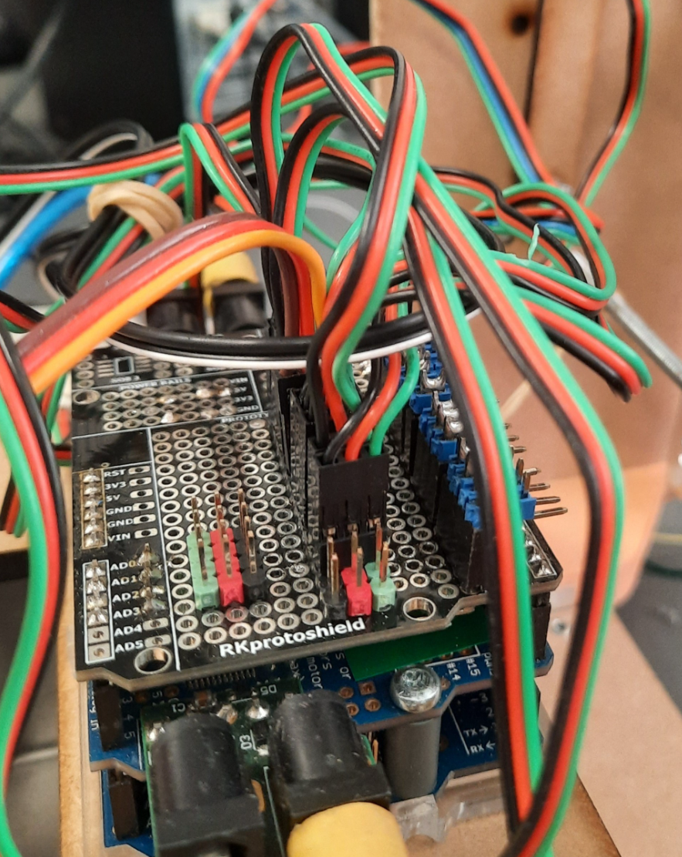
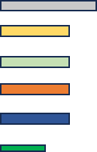
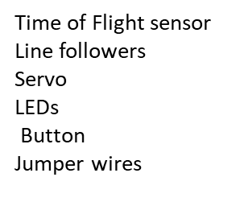
Electrical Development:
Rails for power, ground and connected data pins for easy and modular plug in of sensors.
Modular approach means design can be changed without issues due to soldering directly.

Slide 3
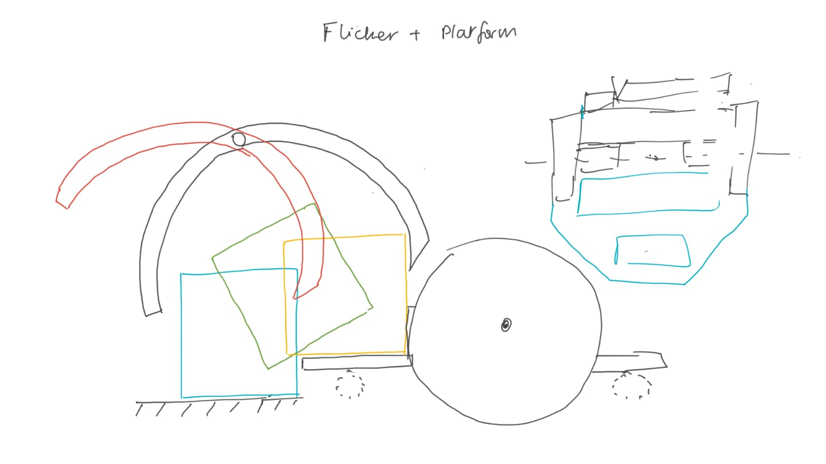
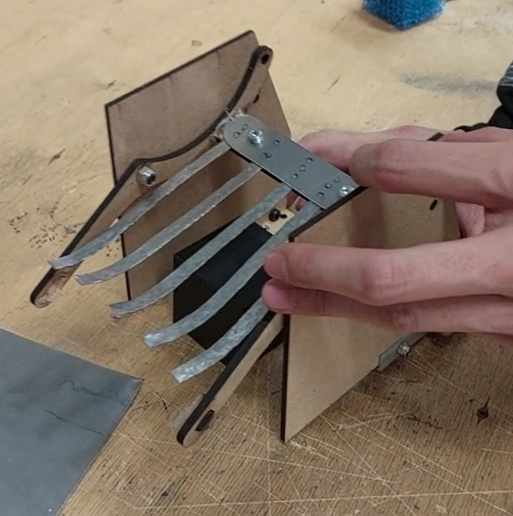
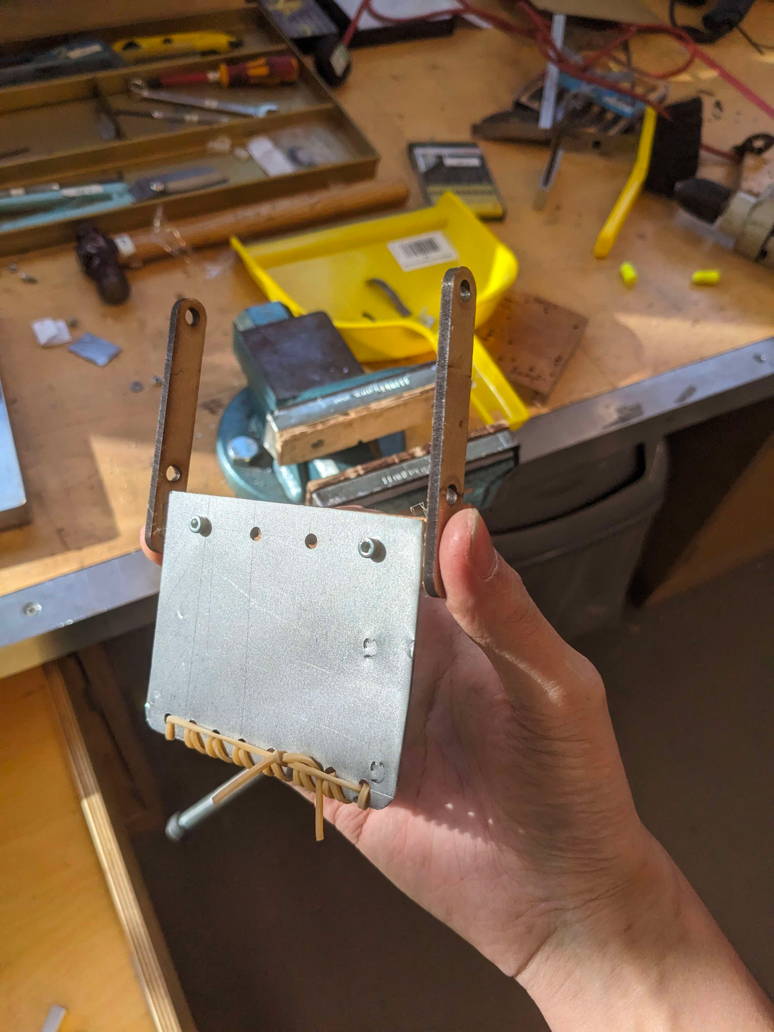
Mechanical Development:
Chassis limit of 200mm
Easier turning in tight spaces
Reduces chances of collisions during line follow
Single motor for block grabbing
Reduces economic and environmental costs
Better for weight distribution
Modular chassis
Can modify in real world for various applications
Initially easier for simultaneous testing
Better height control for mounting mechanisms
Mix of MDF + Alu + Steel Chassis
Sheet metal forming is common and proven method - easily scalable
Standard sized materials - reduced costs
MDF to prevent shorting electronics
Small wheels for more compact design
Initially ran into traction issues with the wheels
Increased precision of chassis to fix this

Slide 4
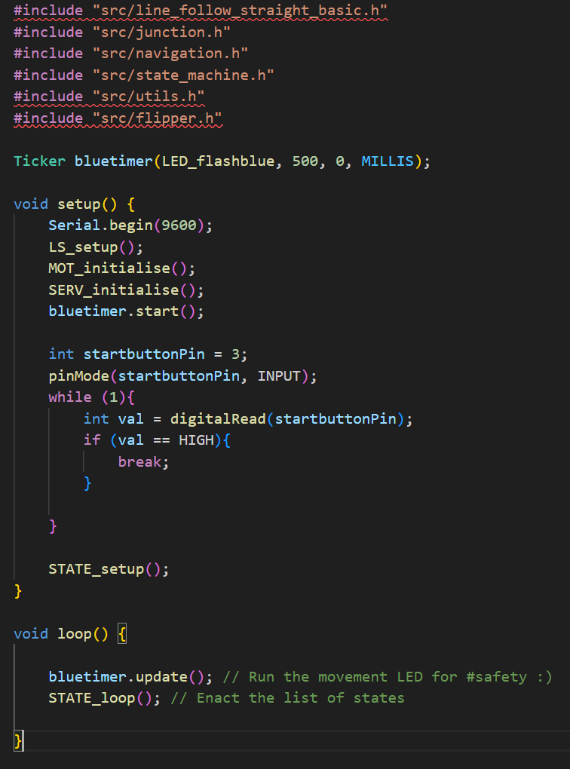
Software development:
Used git branching
System of .cpp and .h files in a common folder
Use of symlinks to declutter the file structure, letting .ino files access the common folder without conflict
One .ino for each test / final program
Test files for motors, flipper, all sensors
Utility file to handle serial feedback, helping with debugging
*Credit to Boris for the start button code

Slide 5
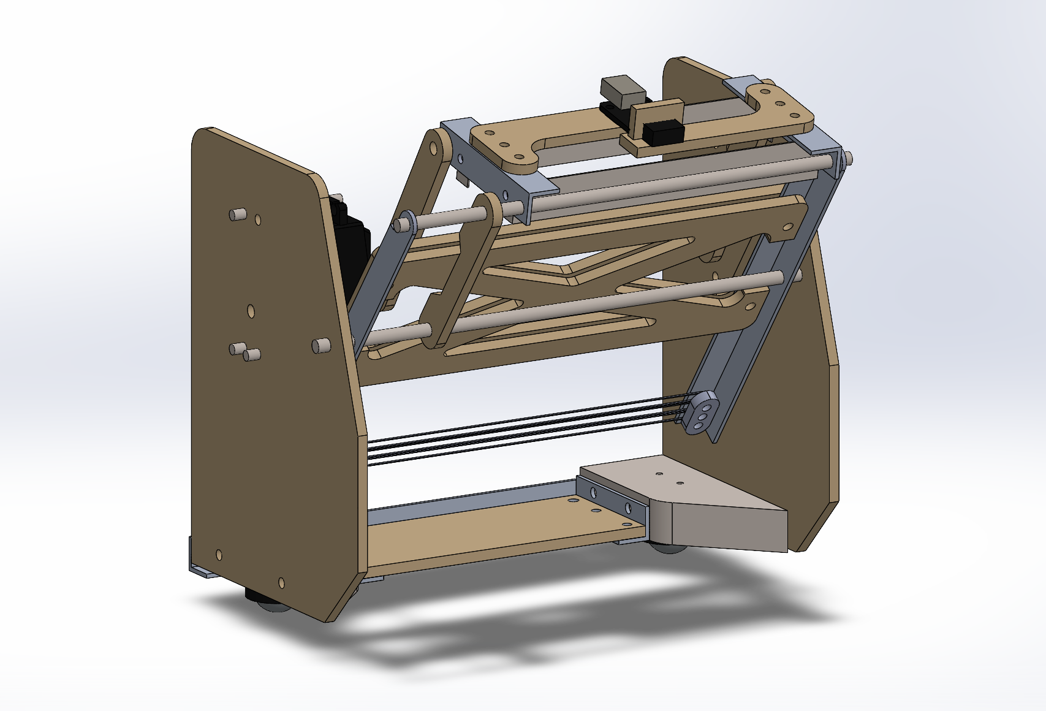
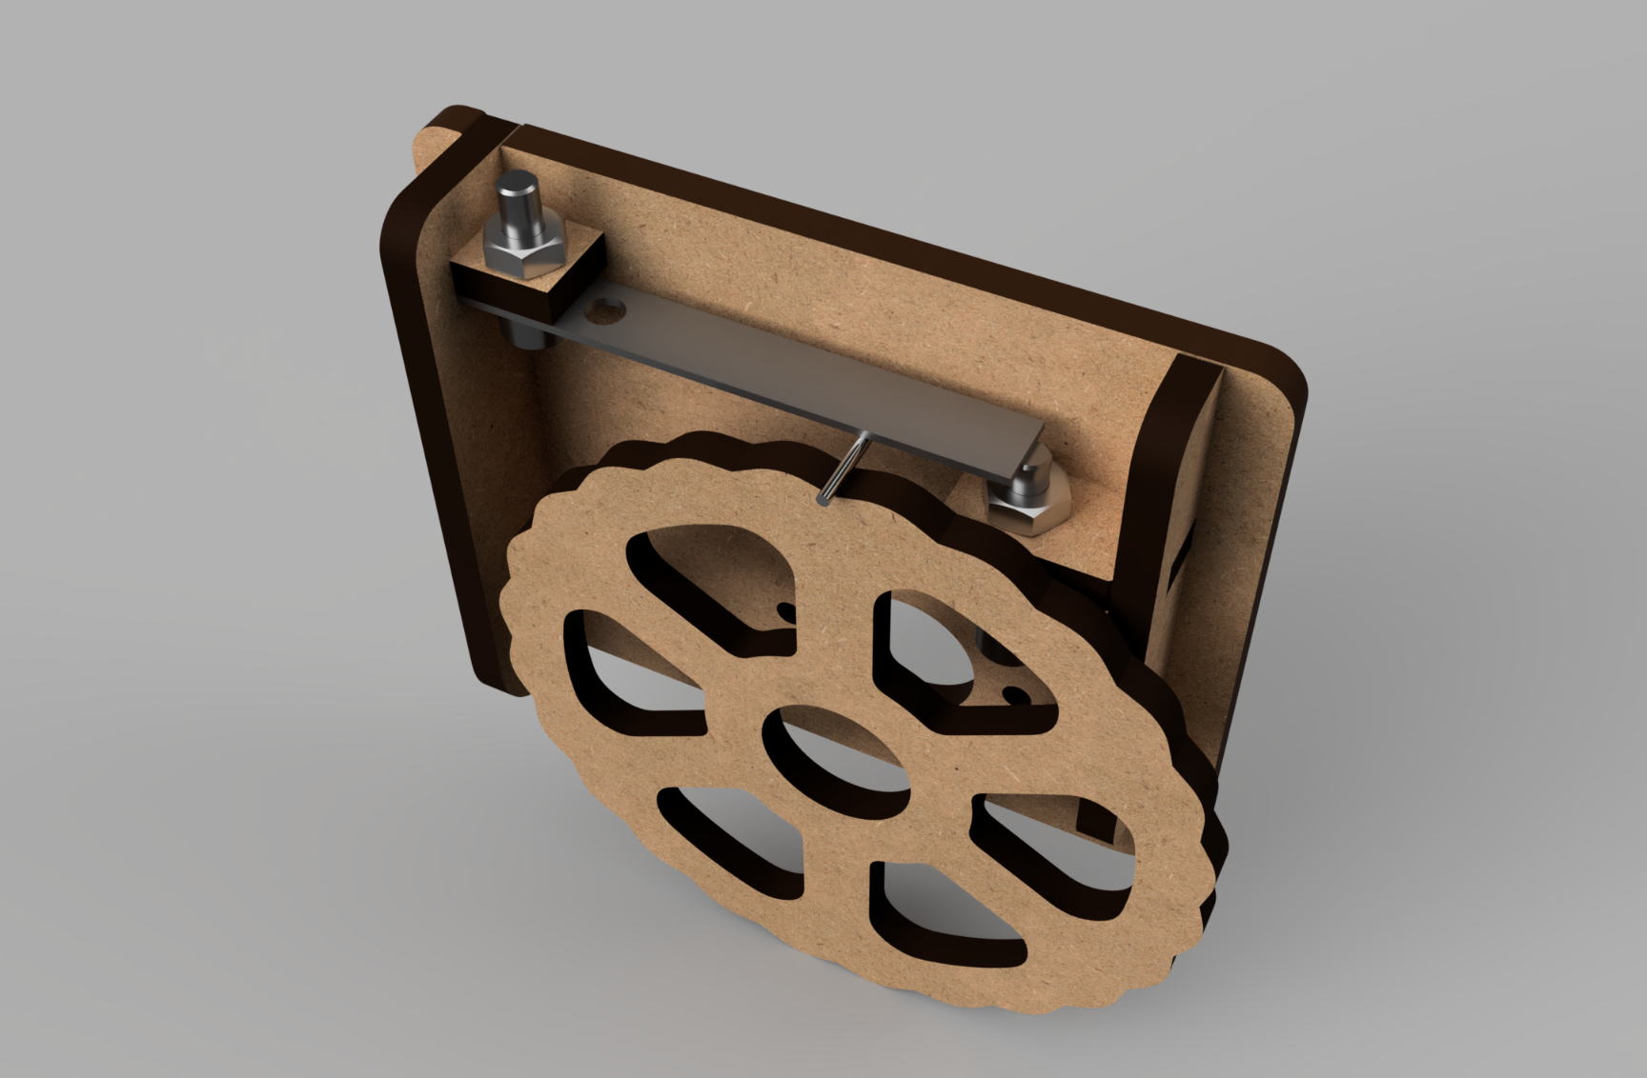
Innovative Ideas
Block flipper
Block intake and lifting accomplished with a single motor
Lower cost when scaling up
Fewer software bugs
Large horizontal tolerance to block position
Block Identification
Accomplished with a flexure and limit switch embedded within the flipper mechanism
Based on difference of rigidity of the blocks
Very reliable once tuned
Wheel Encoders
Allow precise position monitoring and closed loop feedback system
May not be possible to integrate them in time

Slide 6
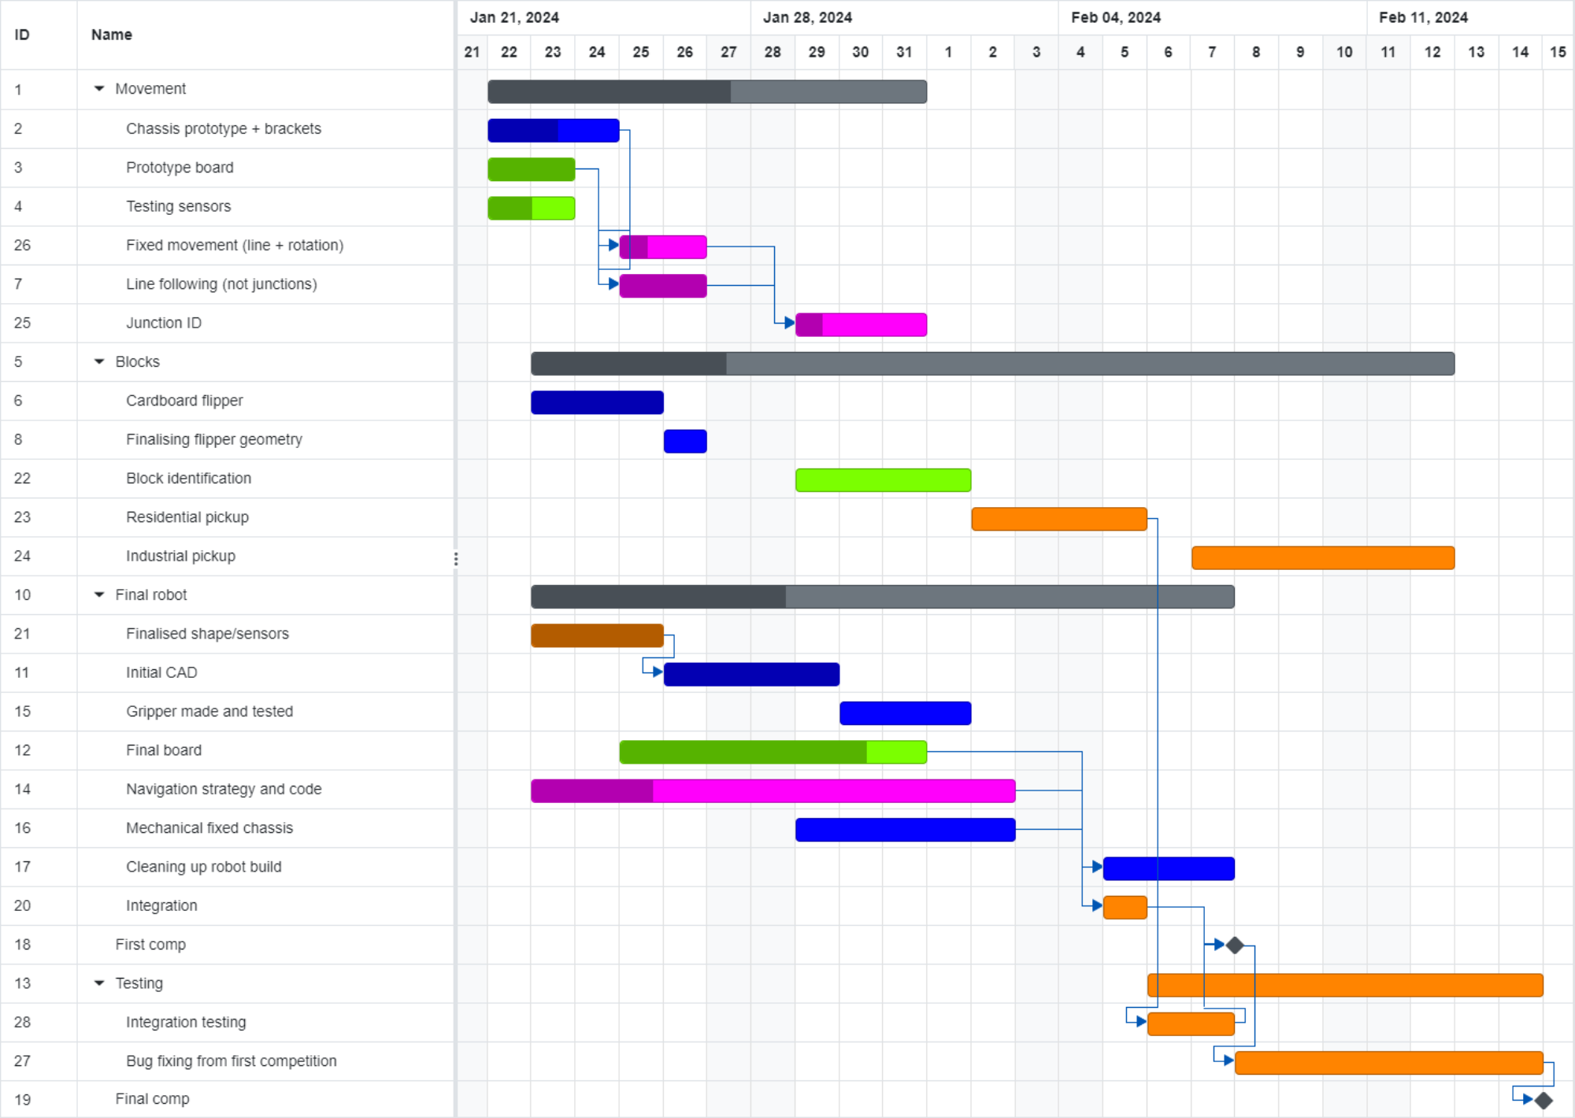
Sources of deviation from gantt chart:
Inconsistent wheel speeds causing robot to get lost - requiring a chassis upgrade and navigation rewrites
Timing of final chassis + flipper did not leave long for integration and testing
Residential pickup took longer than planned as a result

Slide 7
Reflecting on the first competition:
Integration of the flipper + distance sensing was behind schedule
Result was first competition not the useful dress rehearsal it could have been, only demonstrated navigation

Slide 8
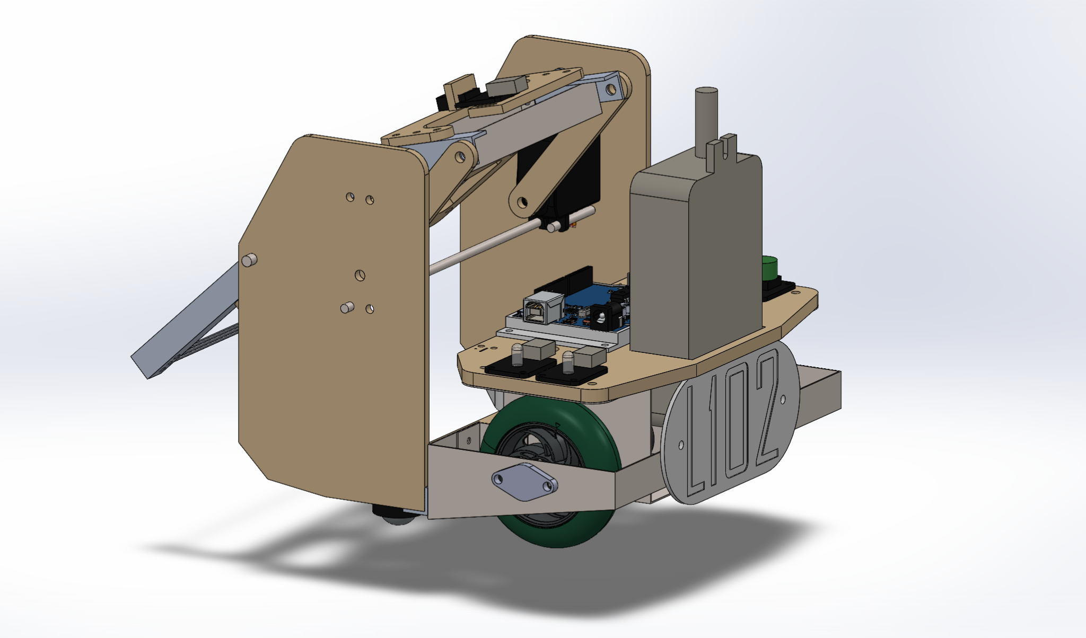
Final competition
Have successfully picked up, identified and delivered a residential block in testing
Currently having an issue with a specific right turn to the red outpost, will need to tweak the approach to it on Tuesday
Identification and delivery of both residential blocks and a return to the finishing box is a feasible outcome for Wednesday

